Slide 1
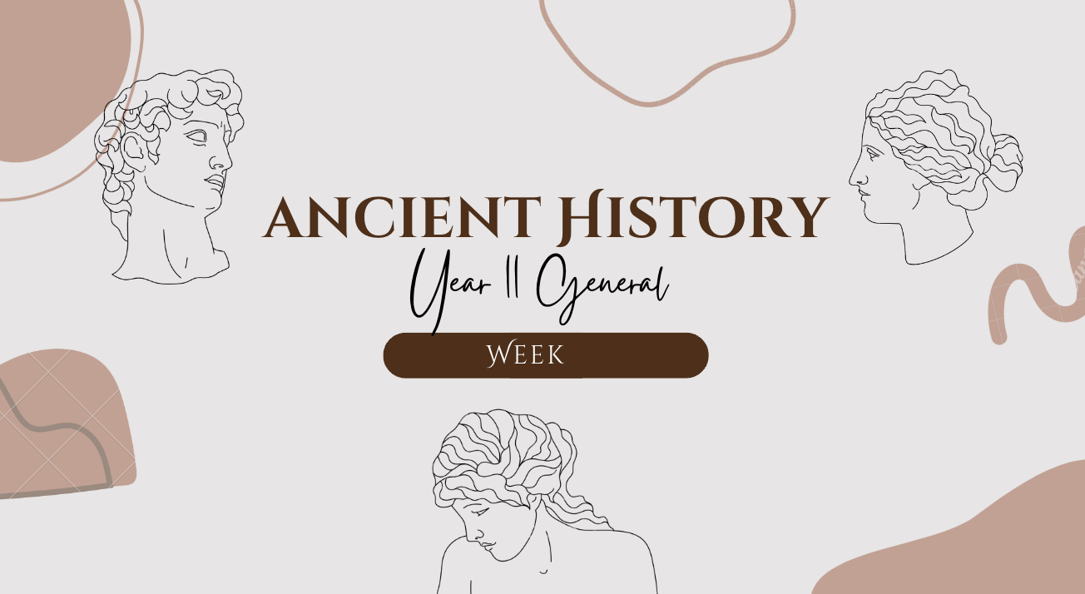
1
GOAL/S: Identify types of stories
Explain the significance of myths
Lesson 2
Ms Barrie

Slide 2
Mythology
DEFINITION: Myth is a folklore genre consisting of narratives that play a fundamental role in a society, such as foundational tales or origin myths
DISCUSSION QUESTION:
What do you already know about Mythology?

Slide 3
Today’s Lesson
Role of mythology – past and present
Story telling

Slide 4

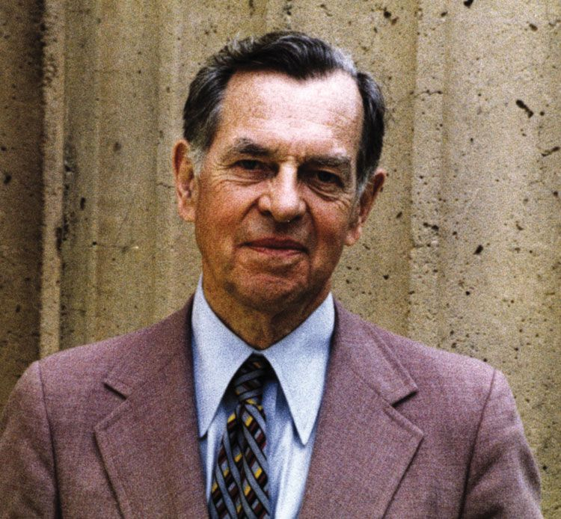
Do you know who these people are?
Notes:
In 1971 G Lucas was in debt and he started writing a movie about a Jedi Warrior – Universal studios didn’t like it
Read Joseph Campbell Texts about narrative structure – resent to 20th C fox

Slide 5
Joseph Campbell
Curiosity about why different cultures had same stories but never come into contact

Slide 6
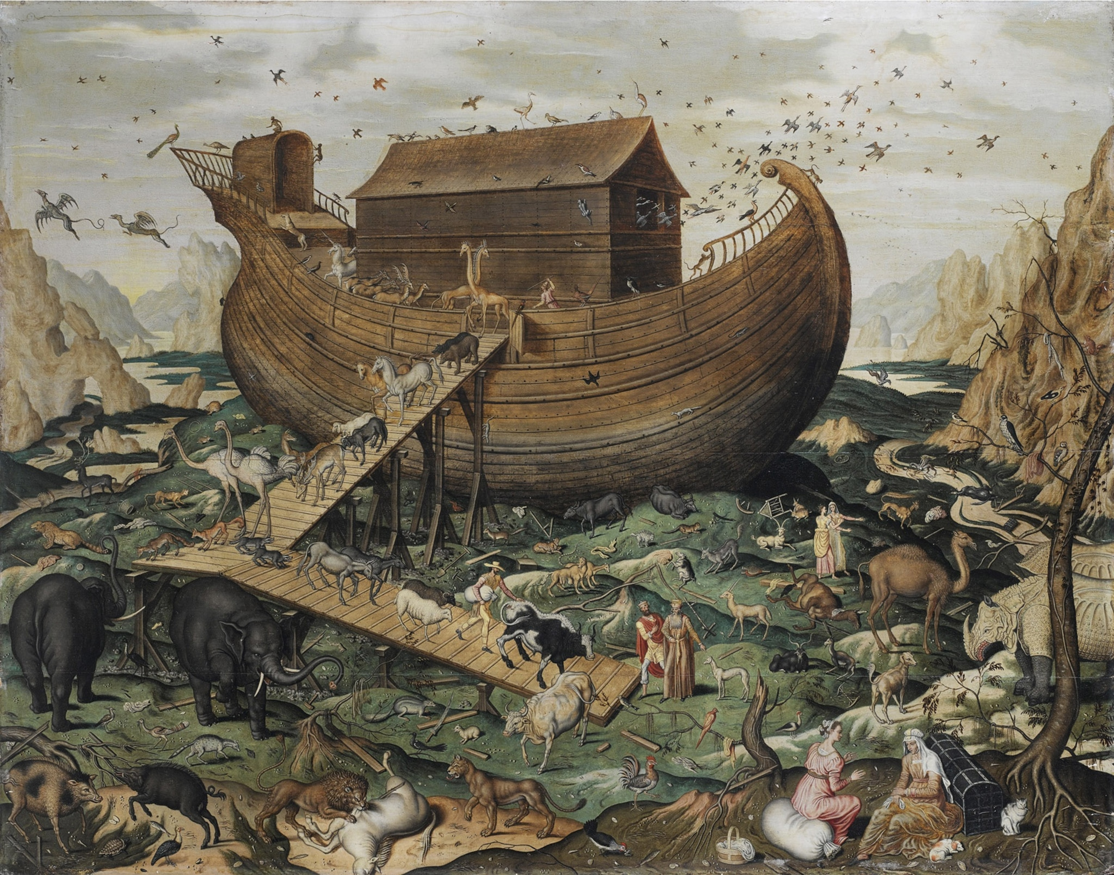
Example: A flood story
EVERY culture has a similar story
e.g. Amazonian, Greek, Asian, Roman, Hebrew
Notes:
Whole earth flooded and things started over – EVERY culture has one

Slide 7
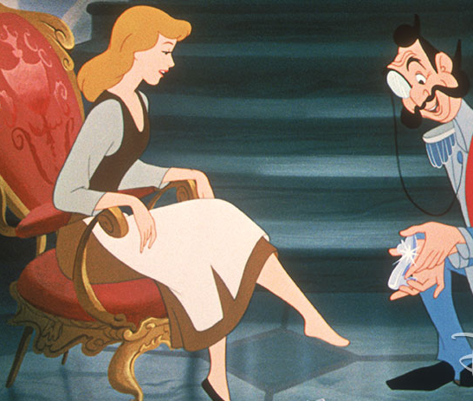
Example: Cinderella story
EVERY culture has a similar story
Someone who has a difficult life, rising out of their station they’re in

Slide 8
Myths based on dreams?!?!?
When you have a dream, every CHARACTER is you
Mythology and psychology are actually connected – perhaps because people are having the same dreams and experiences!
Notes:
SURVEY – falling dream?

Slide 9
Types of Stories
Fable | Myth | Parable
The tortoise and the hare | Little Red Riding Hood | Bible
“Slow and steady wins the race” | “The Story of Grandma” | “The Boy Who Cried Wolf”
FABLES: Describe two sides of the same person. | MYTH: Long story with a journey and the ‘other’, usually without a happy ending (Gods/creatures) Fairytales – important! | PARABLE Teach dual/black and white lesson Morality and importance
Notes:
FABLE – you decide which part of you to pick
MYTH – actually really important to deal with self and others
PARABLE

Slide 10
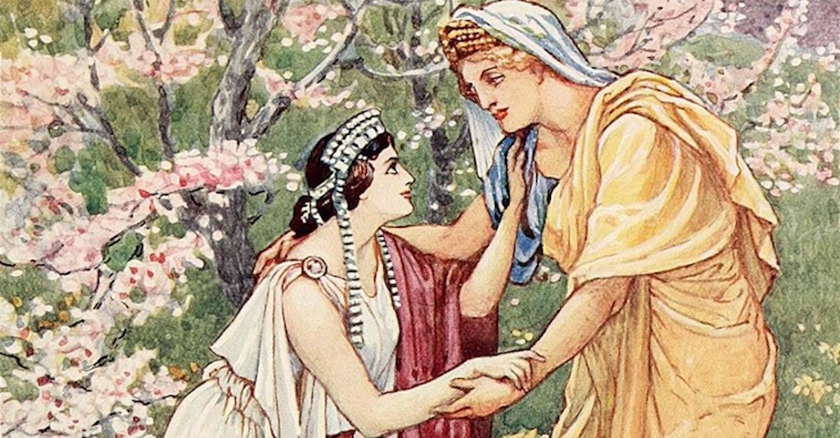
Example: Demeter and Persephone
Notes:
Greek – P getting pomegranates, hades gets from underworld
Demeter LIVID – has a thing with zeus going on.
Zeus agrees and Hades agrees - part of year in world, and some in underworld (3 months)
Demeter goddess of harvest would be heartbroken during 3 months (no grass, cold – greeks used to explain winter)
BUT this didn’t originate with Greeks!
Can be used to explain the world

Slide 11

What should every story have?
Beginning
Middle
End
+ somebody who wants something
+ someone/something standing in the way
Notes:
Stories work how the human brain solves problems
Cat on a blanket VS. Cat on a DOG’s blanket

Slide 12

A hero’s Journey
An elixir – something to go after
But had to return and learn something/share it

Slide 13
Discussion
What are some examples of mythology do you know of?

Slide 14



E.G. Modern Mythology
SUPERHERO CULTURE
Change to fit needs of a culture, helps us deal with what we are seeing
Notes:
1933 – truth/justice/American way
If we do not confront an evil, it will always come back with a different face – that’s why there are so many stories that face same issues

Slide 15
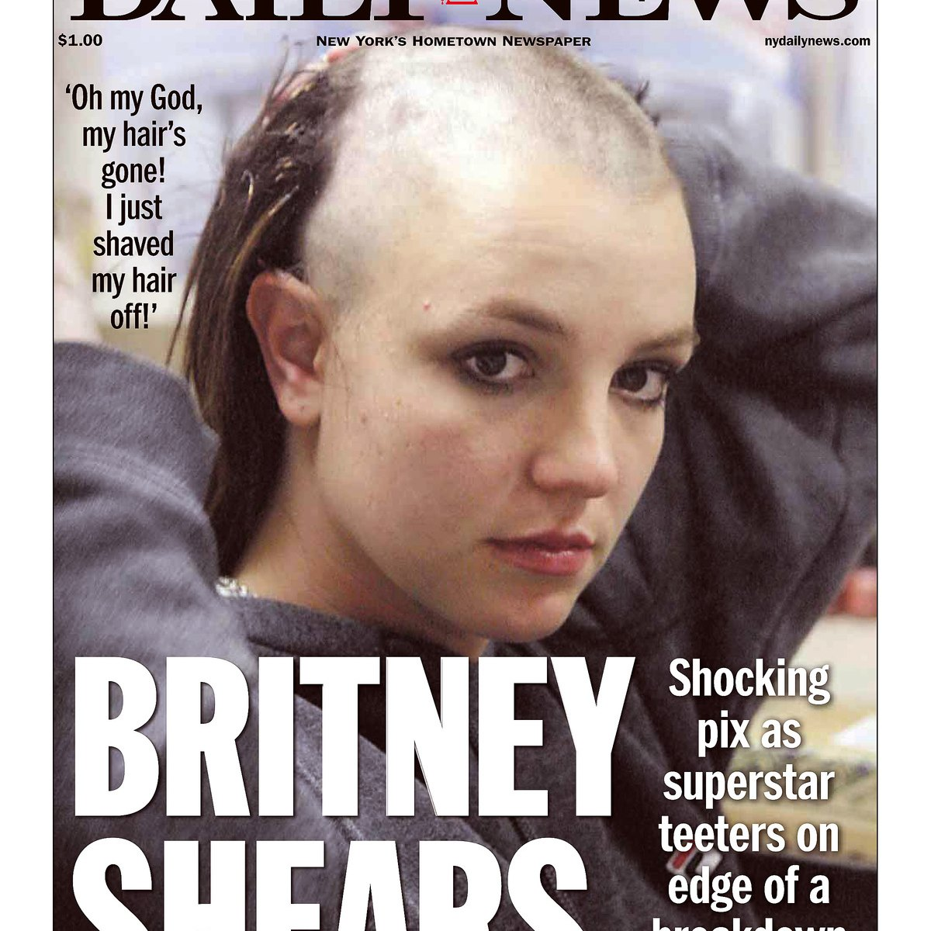
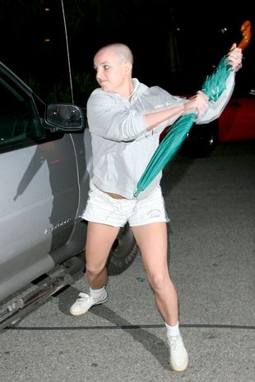
E.G. Modern Mythology
PHARMACOSE – The person to sacrifice to the Gods each year
(pharmacy – ‘soothing of the Gods’)

Slide 16
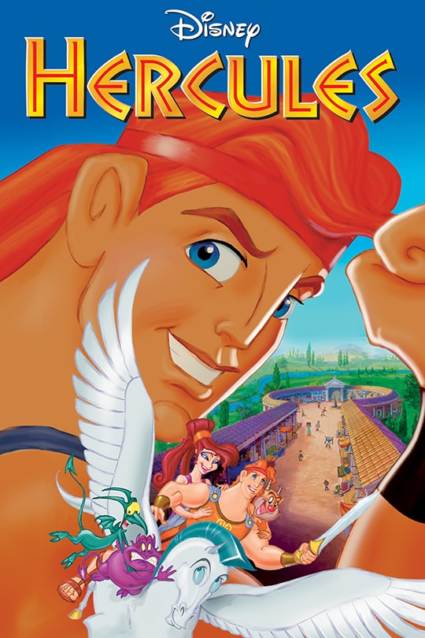
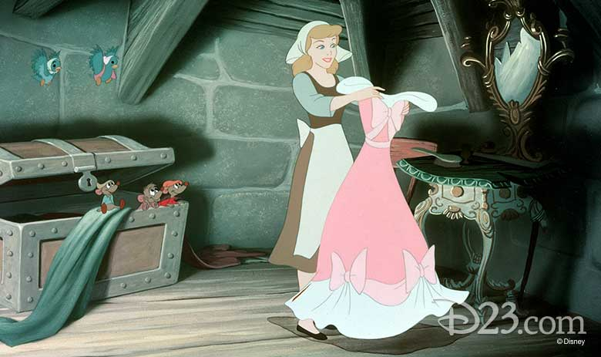

E.G. Modern Mythology
Disney Fairytales

Slide 17
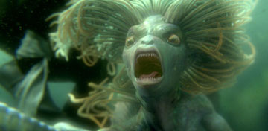
E.G. Modern Mythology
Disney Fairytales – changing the story and characters
Notes:
Sirens/Mermaids to now

Slide 18
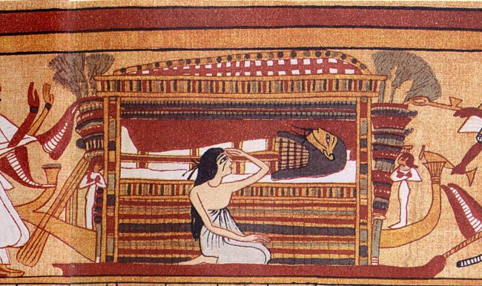
E.G. Modern Mythology
Death and Burial Traditions
Egyptian Mythology – after life
Notes:
Egyptian mythology – Ceremony with coffin, treasured/meaningful items, dressed up, talk to them

Slide 19
Ms Barrie’s Favourite myths
Sisyphus
Echo and narcissus

Slide 20
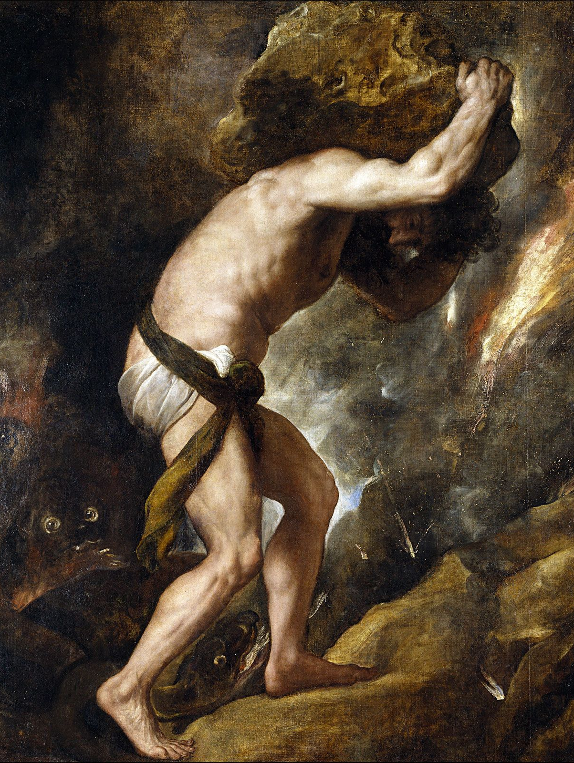
Sisyphus
Greek Mythology
Sisyphus was the founder and king of Ephyra (now known as Corinth).
Hades punished him for cheating death twice by forcing him to roll an immense boulder up a hill only for it to roll down every time it neared the top, repeating this action for eternity.
Notes:
, tasks that are both laborious and futile are therefore described as Sisyphean

Slide 21
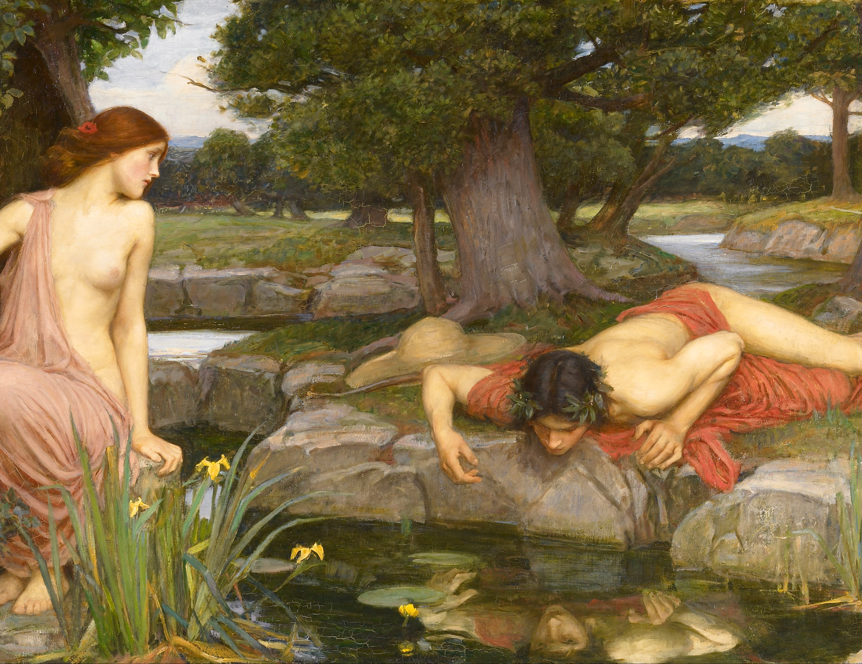
Echo and Narcissus
Roman Mythology
Echo was a talkative nymph – known for their beautiful voice - who was cursed by the God Juno, making her able to only finish a sentence not started, and unable to say anything on her own.
Echo sees a young man – Narcissus – while he was out hunting, and immediately falls in love with him.
While on the hunt, he gets lost and begins to yell out to his friends. Through his yells, they find each other – only for him to be disgusted by her.
The other nymphs pray to Nemesis to punish Narcissus with a love never reciprocated – and he is cursed to fall in love with his own reflection.

Slide 22
Why am I teaching you this?
As we move through this year, I want you to analyze with a lens of WHY.
WHY is something culturally significant?
WHY is something religiously significant?
WHY did people act the way they do?
A lot of the answers to these questions are influenced by mythology.

Slide 23
SUMMARY:
3 things you have learned about myths
2 ways myths can be used
1 sentence explaining why myths are important

Slide 24
EXTENSION VIDEOS:
https://www.youtube.com/watch?v=xQuAUBX5xBw&ab_channel=GeethanjaliKids-RhymesandStories
https://www.youtube.com/watch?v=Ch4dLCG1p2Y&ab_channel=SeeUinHistory%2FMythology

